Slide 1

DATABASE SYSTEMS (EIE36E): EXERCISE #6
Doc. Ing. Václav Vostrovský Ph.D.
Ing. Petr Hanzlík

Slide 2
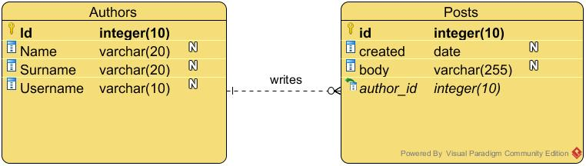

Task 1 – Implement ERD in SQL
*Use Number instead of integer in ORACLE DBMS

Slide 3
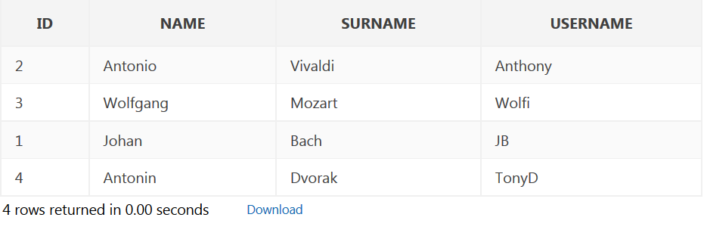
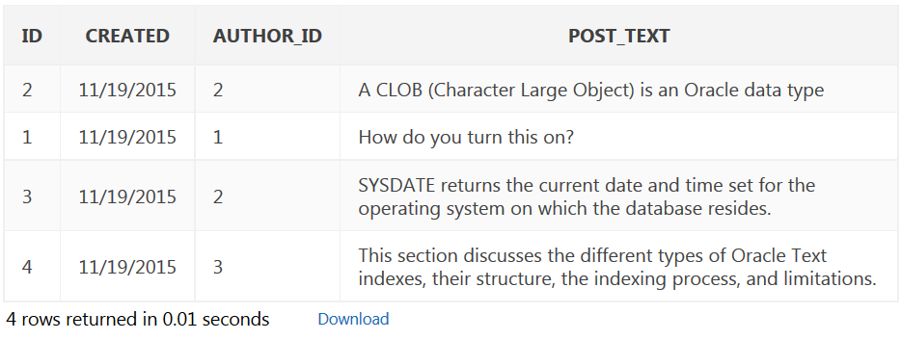
Task 2 – INSERT some data

Slide 4
Task 3 – JOIN/Select from multiple tables
Select the username (only) of authors who wrote at least one post
Select first name + surname of authors with exactly one post
Select username of authors with no posts published

Slide 5
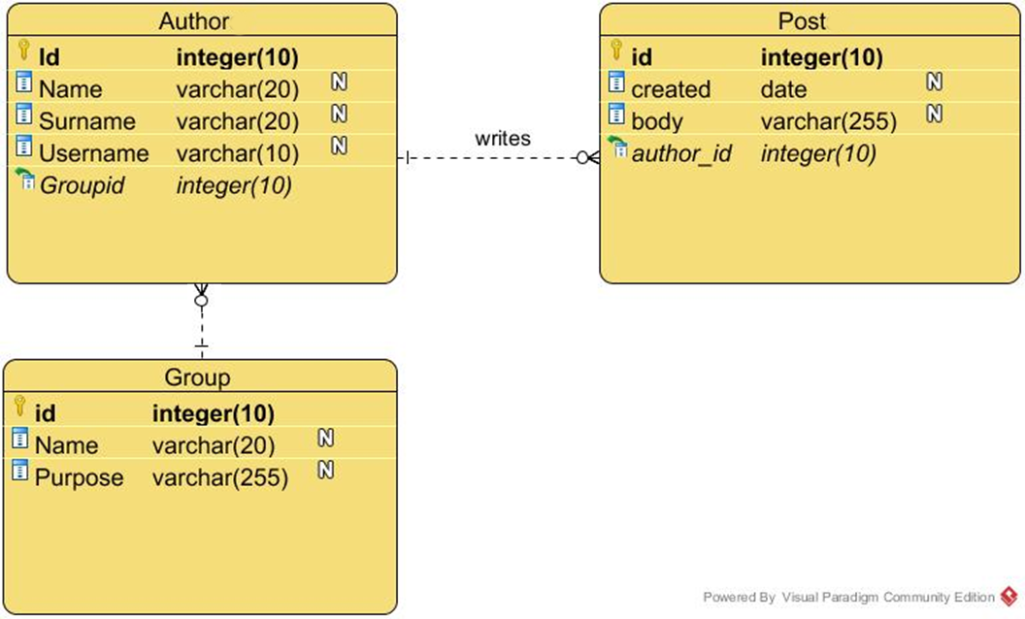
Task 4 – Add a new entity model
*Use Number instead of integer in ORACLE DBMS

Slide 6
Task 5 – Insert new data
Create new user group
Name: gamers, purpose: entertainment
All authors should be modified to belong to this user group

Slide 7
Task 6 –Select from three tables
Select username + group name + date of last comment
Count how many authors belong to the group called ‘gamers’
Count how many posts have been written by all the gamers together?

